Slide 1

ỦY BAN NHÂN DÂN THÀNH PHỐ HỒ CHÍ MINH
TRƯỜNG CAO ĐẲNG LÝ TỰ TRỌNG TP. HỒ CHÍ MINH
Bậc đào tạo: TRUNG CẤP NGHỀ (9+4)
Tên giảng viên: ĐINH TRẦN PHƯƠNG THẢO

Slide 2
ENGLISH FOR
HEAT-REFRIGERATION ENGINEERING TECHNOLOGY
UNIT 4: HEAT TRANSFER

Slide 3
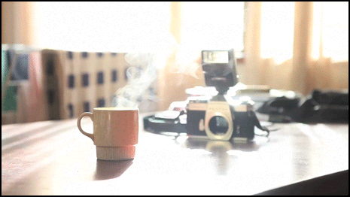
What will happen to the coffee as it continues to sit?
Notes:
Instructional Approach(s): The teacher should present the illustration to provide an example of heat transfer. The teacher should ask the class or call on students to answer the question.

Slide 4
Heat Transfer can occur in three ways:
Conduction
Convection
Radiation
Notes:
Instructional Approach(s): The teacher should present the information on the slide.

Slide 5
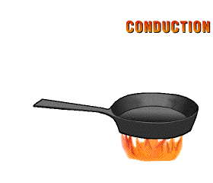
Conduction
Conduction is the transfer of heat by direct contact (particles collide)
Conduction occurs most easily in solids
and liquids
Notes:
Instructional Approach(s): The teacher should present the information on the slide while the students record the important information on their notes

Slide 6
Conduction
Why is conduction easier in solids and liquids?
Atoms and molecules are closer together in solids and liquids. So, the particles need to move only a short distance before they bump into one another and transfer energy.
Notes:
Instructional Approach(s): The teacher should present the information on the slide while the students record the important information on their notes

Slide 7
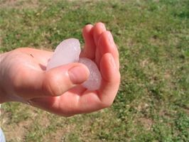
Explain the movement of thermal energy in the picture below.
Notes:
Instructional Approach(s): The teacher should present the illustration to provide an example of conduction. The teacher should ask the class or call on students to answer the question. Click the mouse to reveal the answer.

Slide 8
Faster moving molecules in your warm hand bump against the slower moving molecules in the ice. Thermal energy moves from your warmer hand to the colder ice. The slow moving molecules in the ice move faster.
Notes:
Instructional Approach(s): The teacher should present the illustration to provide an example of conduction. The teacher should ask the class or call on students to answer the question. Do not spend more than 3-5 minutes total time allowing for discussion. When ready, move the next slides to discuss the answer.

Slide 9
How is this an example of Conduction?
Faster moving molecules in your warm hand bump against the slower moving molecules in the ice to transfer thermal energy. Direct contact of the particles occurs; therefore, heat is transferred by Conduction.
Notes:
Instructional Approach(s): The teacher should present the illustration to provide an example of conduction. The teacher should ask the class or call on students to answer the question. Click the mouse to reveal the answer.

Slide 10
Conductors and Insulators
Substances that transfer thermal energy very well are called Conductors.
Substances that do not transfer thermal energy very well are called Insulators.
Notes:
Instructional Approach(s): The teacher should present the information on the slide while the students record the important information on their notes

Slide 11
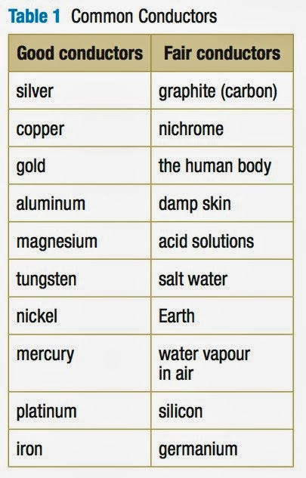
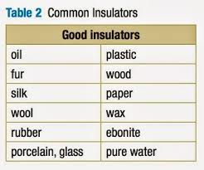
Conductors and Insulators
Notes:
Instructional Approach(s): The teacher should present the information on the slide.

Slide 12
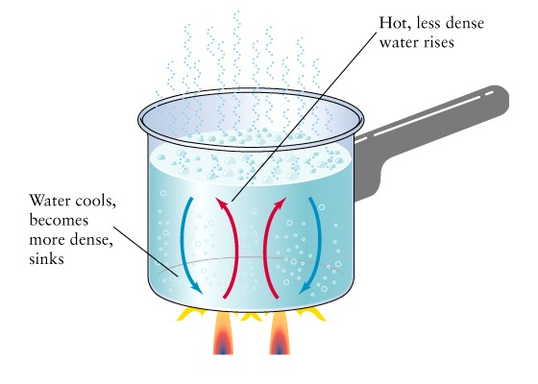
Convection
Convection is the
flow of currents
in a liquid or gas
A current is created when the warmer
(less dense) material rises forcing the
cooler (more dense) material to sink.
Notes:
Instructional Approach(s): The teacher should present the information on the slide while the students record the important information on their notes

Slide 13
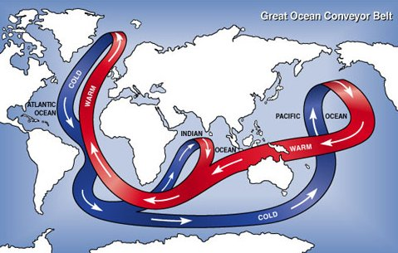
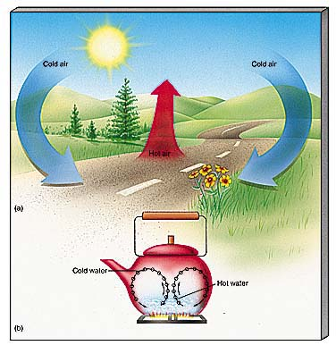
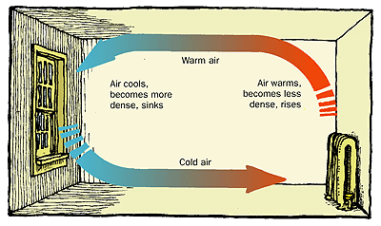
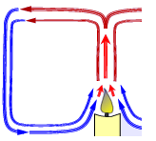
Everyday Examples of Convection Currents
Notes:
Instructional Approach(s): Remind students that in the water cycle, warm air rises, cools and condenses. Students learned about convection currents and the water cycle in the 6th grade.

Slide 14
Describe an example of convection that you have experienced recently at home, at school, or outside.
Convection
Notes:
Instructional Approach(s): This could be used as a formative assessment tool.

Slide 15
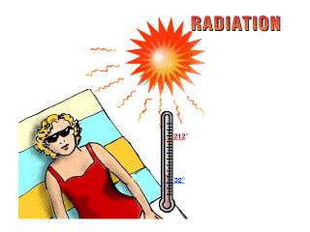
Radiation
Radiation is heat
transfer through space
by electromagnetic waves
Unlike Conduction and Convection,
Radiation can occur in empty space,
as well as in solids, liquids, and gases.
Waves such as visible light, infrared, and ultraviolet light are examples of radiation
Notes:
Instructional Approach(s): The teacher should present the information on the slide while the students record the important information on their notes

Slide 16
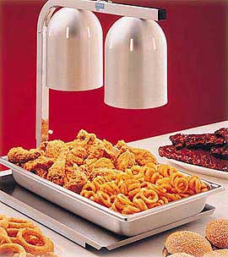
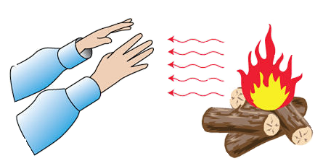
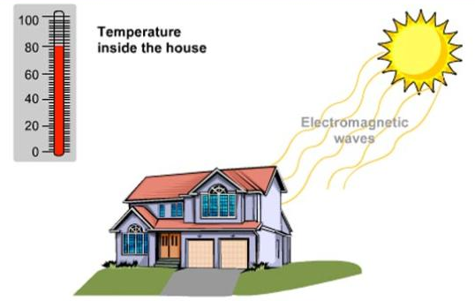
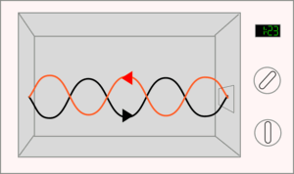
Radiation
Notes:
Instructional Approach(s): The teacher should use the images on the slide to illustrate examples of radiation.

Slide 17
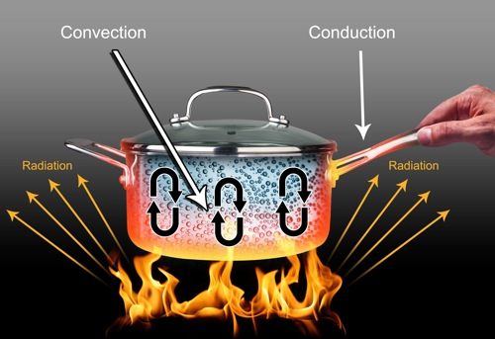
Look at the examples of Heat Transfer in the Image below
Notes:
Instructional Approach(s): The teacher should use the image to illustrate the types of heat transfer

Slide 18
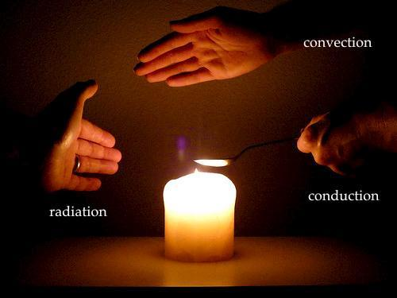
Look at the examples of Heat Transfer in the Image below
Notes:
Instructional Approach(s): The teacher should use the images on the slide to illustrate examples of conduction, convection, and radiation.

Slide 19
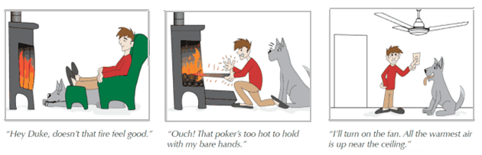
Look at the three images below. Identify which is an example of conduction, convection, and radiation.
A.
B.
C.
Notes:
Instructional Approach(s): The teacher should present the illustration. The teacher should ask the class or call on students to answer the question. Click the mouse to reveal the answer.

Slide 20
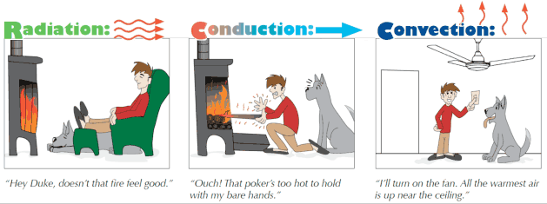
Look at the three images below. Identify which is an example of conduction, convection, and radiation.
Notes:
Instructional Approach(s): The teacher should present the illustration. The teacher should ask the class or call on students to answer the question. Click the mouse to reveal the answer.

Slide 21
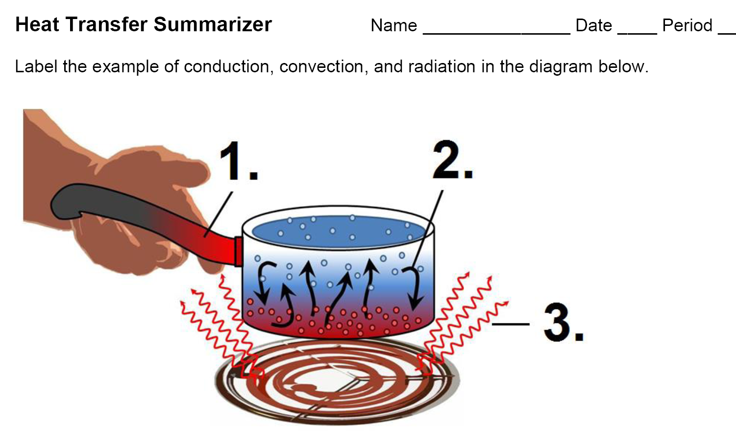
Heat Transfer Summarizer
Notes:
Instructional Approach(s): Instructional Approach(s): Each student should complete the summarizer. The teacher should use the summarizer to determine the level of student mastery and if differentiation is needed.

Slide 22
Notes:
Instructional Approach(s): The teacher should use the summarizer as a formative assessment to determine differentiation.

Slide 24




THANK YOU VERY MUCH

